Slide 1
Microservices and DevOps
DevOps and Container Technology
TestContainers
Henrik Bærbak Christensen

Slide 2
Motivation
Service tests, Consumer Driven Tests, test journeys
Fowler: Component tests out-of-process, contract tests,…
… all requires that you do automated testing of multiple services being started for testing purposes
Which means you have to start services from within JUnit, which is seldom easy…

Slide 3
The Pesky Network
What are our Options?

Slide 4
Test Across Network
Daemon
Player Servant
FakeCS
PlayerProxy
<<i>>
CaveStorage
MongoDB
RealCS
FakeQS
<<i>>
QuoteService
QuoteServer
RealQS
…
= Local call
= Network call

Slide 5
The Easy Case
One case is do-able, however.
Starting a Spark-Java web server can easily be done in JUnit.
Linux Issue!
Releasing a port takes a loong time.
Use random port in each @Before

Slide 6
The Easy Case
You may now formulate JUnit test cases that directly contact that server
Actually runs reasonably fast …

Slide 7
The Tricky Cases
But What do I do if the external service is
A database, like MariaDB, MongoDB, Redis, …?
A web service I do not develop myself?
Like the other groups in the course and you need to validate their service using CDTs
Even worse – some external service that only runs in one instance???

Slide 8
Some Options
PowerMock
mock(UniRest) cumbersome
Provided mock frameworks
Fongo for Mongo available?
Test double services
Mountebank only http
Call system/OS processes
ProcessBuilder() os dependent/flaky
TestContainers
Run docker within JUnit cool stuff!

Slide 9
TestContainers
Running Docker from JUnit

Slide 10
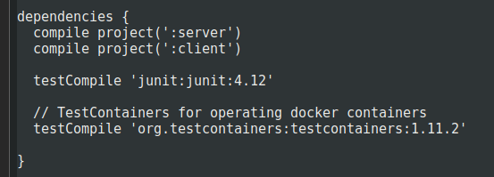
Getting It
Gradle to the rescue
1.15.2 / 1.16.0

Slide 11
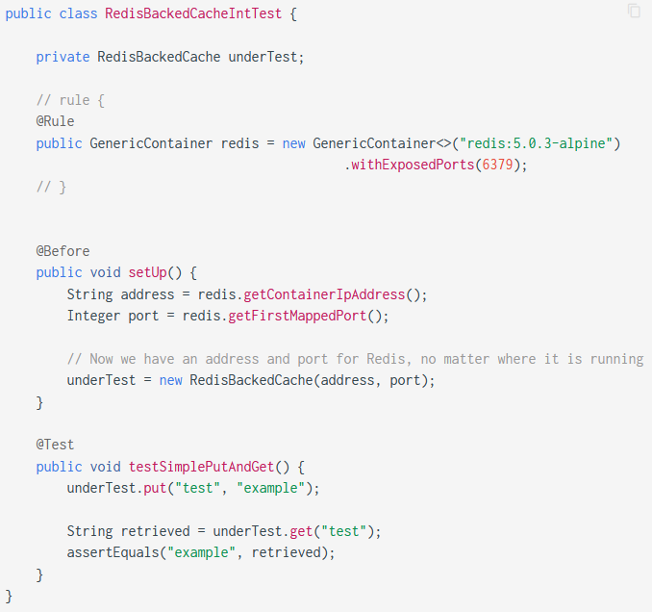
GenericContainer
@Rule
Creates a ‘redis’ for each test
Tell exposed port (-p)
Randomized port mapping
Configure our ‘driver’
Write your tests as normal
Looks a bit different in latest version

Slide 12
And Run…
Run slowly, but still…

Slide 13
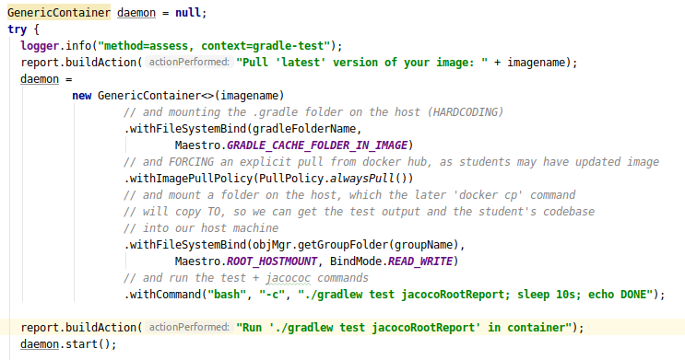
Lots of Control, Vast API
You can configure your docker ‘run’ detailed
Force image pull, mount folders, set run command

Slide 14
Lots of Control, Vast API
You can start/stop containers

Slide 15
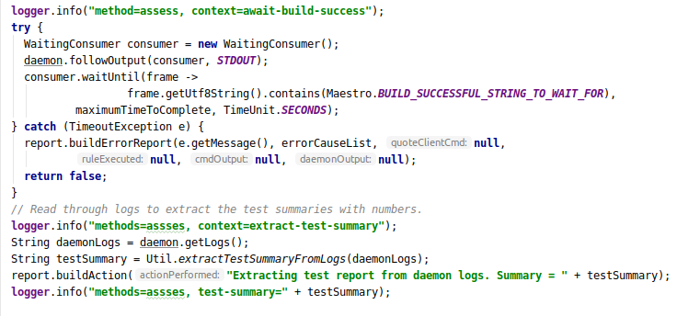
You can monitor output
By ‘consumers’

Slide 16
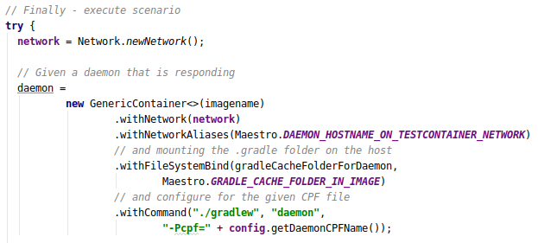
You can control networks
‘docker network create’, and ‘—name (myname)’
Note: Only 16 networks available ☹. Unless you tweak Docker…

Slide 17
Failure Modes
Sometimes TestContainers choke
‘IllegalStateException: could not connect to ryuk’
Do the following
Restart your Docker service!
Either restart your VM; or ‘sudo service docker restart’
‘docker pull testcontainers/ryuk’
I have experience that ryuk (a support container) is not pulled and thus missing

Slide 18
Summary
Out-of-process integration testing is tedious…
TestContainers provides a robust way of making all the docker power available directly in JUnit…

